Slide 1


MAR BASELIOS INSTITUTE OF TECHNOLOGY AND SCIENCE
NELLIMATTOM, KOTHAMANGALAM
DEPARTMENT
OF
COMPUTER SCIENCE AND ENGINEERING
AIRFARE FORECASTING
Project Guide
Dr.Suji Pramila R
Associate professor,
Dept. of CSE
Submitted By
Group No:13
Aadhil Muhammed K K (MBI20CS001)
Alan Sha (MBI20CS006)
Sojan P Renny (MBI20CS054)

Slide 2
Abstract
Introduction
Objectives
Literature Survey
Drawbacks of Existing System
Proposed System
Software and Hardware Requirements
Architecture
Module Specification
Conclusion
References
CONTENTS

Slide 3
ABSTRACT
Predicting airfare involves considering factors like booking time, seasonality, and demand.
Machine learning models, utilizing historical data, can help forecast prices.
Popular algorithms include regression and neural networks.
A set of relevant features is extracted from the data and used to train data from two domains: Machine Learning (ML), Deep Learning (DL)
The findings suggest that AI-based airfare prediction models can effectively identify pricing patterns and assist end users in finding the most cost-effective travel options.
This is a machine learning project in which regression and VGG16 is used

Slide 4
INTRODUCTION
Initially, airline flights were considered a luxury due to static pricing policies and a focus on domestic routes.
To enhance profitability, airline companies adopted management and economic software systems to optimize routes, adapt reservations, and implement dynamic pricing.
The expansion of international destinations and dynamic pricing fueled competition among airlines, making air travel more accessible to a broader range of consumers.
Flight rating systems and online reviews have empowered consumers to share their experiences, influencing pricing decisions and driving airlines to improve their services.
Market globalization and technological advancements have transformed the airline industry, making it more customer-centric, competitive, and accessible.

Slide 5
OBJECTIVES
To compare airfare policies.
To find affordable ticket costs.
To analyze airfare prices.
To predict and evaluate with AI models.

Slide 6
LITERATURE SURVEY
SI.NO | PAPER | METHODOLOGY USED | ADVANTAGES | DISADVANTAGES
1. | T. Kalampokas, K. Tziridis, N. Kalampokas, A. Nikolaou And G. Kostopoulos, "A Holistic Approach On Airfare Price Prediction Using Machine Learning Techniques," In IEEE Access, Vol. 11, Pages 46627-46643, 2023. | Predicts plane ticket costs for various flights. Uses data from Airline Origin and Destination Survey, Air Carrier Statistics, and economic data. Applies machine learning methods. | Uses reliable public data Integrates diverse data for complexity High accuracy | Requires specialized hardware Lower performance than traditional neural networks Robustness.
2. | C. Direkoglu, ‘‘Abnormal crowd behavior detection using motion information images and convolutional neural networks,’’ IEEE Access, vol. 8, pp. 80408–80416, 2020. | New service optimizes airline ticket timing. Data collected from online travel agencies. Utilizes PACES strategy for evaluation. PACES outperforms other strategies in real-world . | Price dynamics Adaptive updates Efficient clustering | Misses preferences, external factors Possible data errors Risks cost misestimation.

Slide 7
LITERATURE SURVEY
SI.NO | PAPER | METHODOLOGY USED | ADVANTAGES | DISADVANTAGES
3. | Ingold A, Huyton J R.:Yield Management And The Airline Industry. “A Regression Model For Predicting Optimal Purchase Timing For Airline Tickets” In IEEE Access ,Pages 179-197 , 2011. | Compared ticket price prediction: Gradient Boosting vs. Linear Regression. Tested on two airline datasets. Significant difference (p<0.05) found. Concludes Gradient Boosting more effective. | Relies on public data Combines diverse sources Uses ML for accuracy | Misses competition Possible errors Focus imbalance Requires updates.
4. | Misuk Lee, Xinpan Mu, Yiqiao Zhang, “A Machine Learning Approach To Improving Forecasting Accuracy Of Hotel Demand”: A Comparative Analysis Of Neural Networks And Traditional Models’, Issues In Information Systems, Vol. 21, Issue 1, Pages 12-21, 2020. | Deep learning predicts Indian airline fares, analyzes factors. Employs visualizations: correlation matrix, boxplot, etc. Random forest and gradient boost yield highest accuracy. | Deep learning prediction Factors analysis High accuracy | Omits method comparison Lacks model details Ignores ethics.

Slide 8
LITERATURE SURVEY
SI.NO | PAPER | METHODOLOGY USED | ADVANTAGES | DISADVANTAGES
5. | Ataman, Görkem, And Serpil Kahraman. “Stock Market Prediction In Brics Countries Using Linear Regression And Artificial Neural Network Hybrid Models.” The Singapore Economic Review,Pages 635-653, 2021. | Introduces ACER for predicting lowest flight ticket prices. Uses clustering and regression for various contexts. Dynamically adjusts features for accuracy. Outperforms other models on real flight data. | Captures patterns, trends Adapts to change Enhances accuracy | Struggles with events Introduces errors Risks losing consistency
6. | w. Xiong Et Al., “Toward Human Parity In Conversational Speechrecognition,” IEEE/ACM Trans. Audio Speech Lang. Process., Vol. 25, Pages. 2410–2423, 2017. | Introduces MS-SSA-LSTM for stock prediction. Combines sentiment analysis, swarm intelligence, and deep learning. Utilizes East Money forum data for optimization. Outperforms other models by 10.74% in R2. | Combines multi-source data Optimizes LSTM hyperparameters Enhances predictive performance | Specialized hardware needed Lower performance Input sensitivity impacts.

Slide 9
LITERATURE SURVEY
SI.NO | PAPER | METHODOLOGY USED | ADVANTAGES | DISADVANTAGES
7. | M. M. Rounaghi And F. N. Zadeh, ‘‘Investigation Of Market Efficiency And Financial Stability Between S&P 500 And London Stock Exchange: Monthly And Yearly Forecasting Of Time Series Stock Returns Using ARMA Model”, Vol. 456, Pages 10–21, 2016. | Proposes sentiment-based stock price prediction using optimized deep learning. Utilizes online sentiment analysis. Applies deep learning for stock pattern recognition. Optimizes with genetic algorithm for accuracy and stability. | Answers image queries Generates concise descriptions Transcribes text from images | Relies on sentiment analysis Sensitive Sparrow Algorithm
8. | W.Zeng,‘‘Research on the relationship between enterprise product innovation ability, product innovation, and process innovation mode,’’ Bus. Admin., Huazhong Univ. Sci. Technol,Pages 323-336, 2012. | Introduces GSADF-TOPSIS-BP model for pricing multi-characteristic products. Reflects accurate product value by considering features, demand, and preference. Applies method in case study, comparing with traditional approaches. | Scientific pricing method Enhances competitiveness, profitability Minimizes errors, risks | Multi-model approach GSADF limitations TOPSIS drawbacks.

Slide 10
LITERATURE SURVEY
SI.NO | PAPER | METHODOLOGY USED | ADVANTAGES | DISADVANTAGES
9. | D. Reebadiya, R. Gupta, A. Kumari, and S. Tanwar, ‘‘Blockchain And AI- integrated Vehicle-Based Dynamic Parking Pricing Scheme,’’ in Proc. IEEE Int. Conf. Commun. Workshops, Pages 1–6, 2021. | Introduces PADAaV: blockchain-based parking price prediction. Aims for better traffic management, reduced congestion, and pollution. Uses smart contracts and neural networks for prediction. Provides driver incentives and evaluates through simulations. | Dynamic parking prices Blockchain security Driver data participation. | Requires trust, cooperation Scalability, performance issues High transaction costs, energy
10. | R. Gupta, A. Kabundi, and S. M. Miller, ‘‘Forecasting the US Real House Price Index: Structural and Non-Structural Models With and Without Funda- mentals,’’ Econ. Model, Pages 2013–2021, 2011. | Introduces self-attention model for house price prediction. Identifies crucial features and captures complex relationships. Outperforms other models in Taipei and New Taipei City. | Diverse data prediction Spatial transformer extraction Joint self-attention features | Requires web context Limited predefined tools Struggles with complexity.

Slide 11
DRAWBACKS OF EXISTING SYSTEM
Ignores airfare changes.
Doesn't assist in booking.
Doesn't compare with other methods

Slide 12
PROPOSED SYSTEM
The proposed system aims to develop a model that predicts airfare using machine learning and deep learning model
Helps to evaluate optimal ticket prices
Gather data from airfare price data set which is publically available
The best result is found comparing the machine learning and deep learning technique using performance matrix analysis
Using python tkinter the GUI interface is integrated

Slide 13
SOFTWARE REQUIREMENTS
Tool: Python IDLE, Visual Studio Code, Anaconda
Python: version3
Operating System: Windows 10

Slide 14
HARDWARE REQUIREMENTS
Processor: i5 or i7
RAM: 8 GB (Minimum)
Hard Disk: 500GB SSD or above
Mouse
Keyboard

Slide 15
ARCHITECTURE
TRAINING MODULE
PREDICTION MODULE
GUI INTEGRATION MODULE
Saved Model
Selecting Accurate model
Python tKinter
VGG13 Model, Decision tree model
Input Data
Prediction
Train Test Split
Display price
Perform EDA
Data preprocessing
Save Price
Dataset

Slide 16
MODULE SPECIFICATION
Training module:
Data preprocessing
Splitting and labelling
Prediction module
Input test data
Prediction
GUI integration module
Python tkinter
Display result

Slide 17
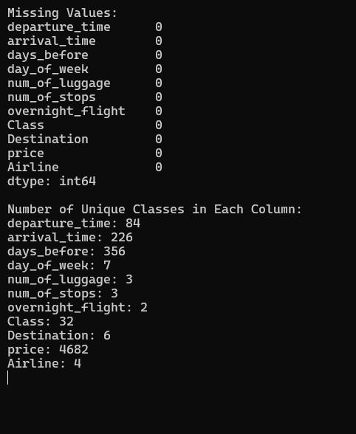
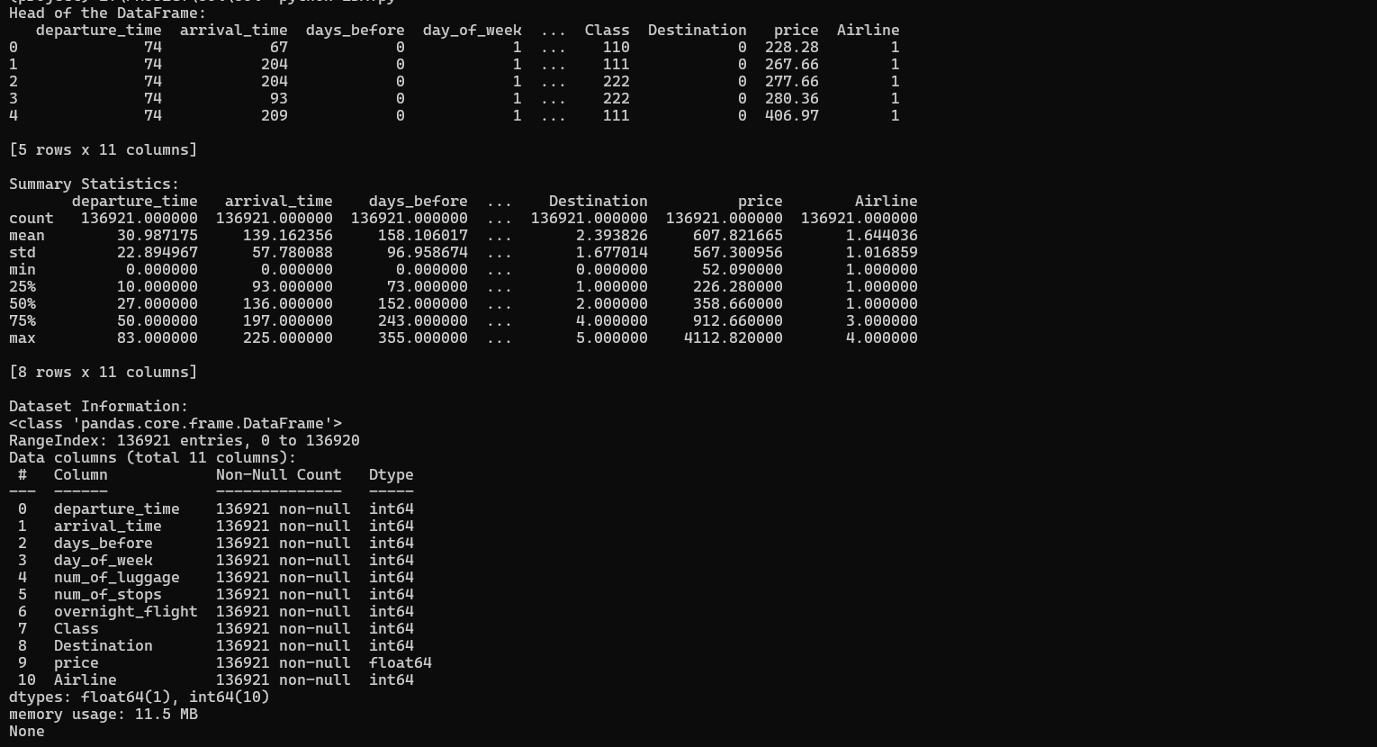
OUTPUT

Slide 18
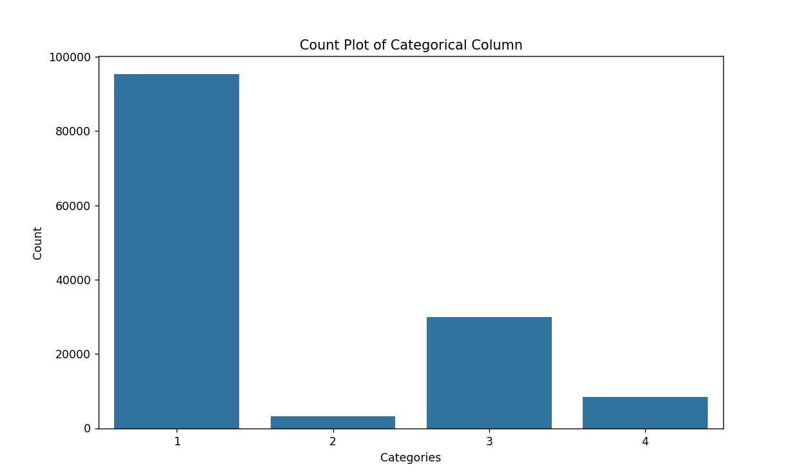
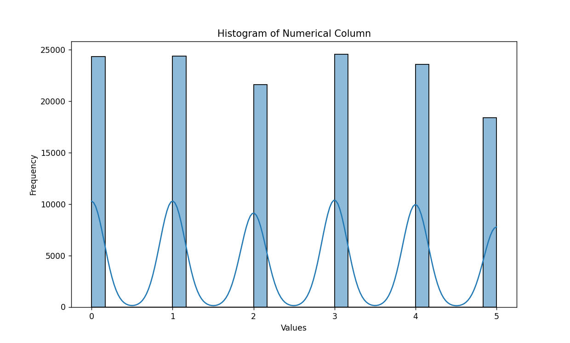
EXPECTED OUTPUT

Slide 19
CONCLUSION
The proposed airfare prediction system represents a cutting edge ,adaptable and comprehensive solution that combines both the power of machine learning and deep learning to predict the airfare for the customers.
This work focuses on predicting airfare prices using different datasets and technologies

Slide 20
REFERENCES
[1] T. Kalampokas, K. Tziridis, N. Kalampokas, A. Nikolaou And G. Kostopoulos, "A Holistic Approach On Airfare Price Prediction Using Machine Learning Techniques," In IEEE Access, Vol. 11, Pages 46627-46643, 2023.
[2] Oren Etzioni, Rattapoom Tuchinda, Craig A Knoblock, And Alexander Yates. “To Buy Or Not To Buy: Mining Airfare Data To Minimize Ticket Purchase Price”. In Proceedings Of The Ninth ACM SIGKDD International Conference On Knowledge Discovery And Data Mining, Pages 119-128 , 2003.
[3] Ingold A, Huyton J R.:Yield Management And The Airline Industry. “A Regression Model For Predicting Optimal Purchase Timing For Airline Tickets” In IEEE Access ,Pages 179-197 , 2011.

Slide 21
REFERENCES
[4] Misuk Lee, Xinpan Mu, Yiqiao Zhang, “A Machine Learning Approach To Improving Forecasting Accuracy Of Hotel Demand”: A Comparative Analysis Of Neural Networks And Traditional Models’, Issues In Information Systems, Vol. 21, Issue 1, Pages 12-21, 2020.
[5] Ataman, Görkem, And Serpil Kahraman. “Stock Market Prediction In Brics Countries Using Linear Regression And Artificial Neural Network Hybrid Models.” The Singapore Economic Review,Pages 635-653, 2021.
[6]w. Xiong Et Al., “Toward Human Parity In Conversational Speechrecognition,” IEEE/ACM Trans. Audio Speech Lang. Process., Vol. 25, Pages. 2410–2423, 2017.
[7] M. M. Rounaghi And F. N. Zadeh, ‘‘Investigation Of Market Efficiency And Financial Stability Between S&P 500 And London Stock Exchange: Monthly And Yearly Forecasting Of Time Series Stock Returns Using ARMA Model”, Vol. 456, Pages 10–21, 2016.

Slide 22
References
[8] W.Zeng,‘‘Research on the relationship between enterprise product innovation ability, product innovation, and process innovation mode,’’ Bus. Admin., Huazhong Univ. Sci. Technol,Pages 323-336, 2012.
[9] D. Reebadiya, R. Gupta, A. Kumari, and S. Tanwar, ‘‘Blockchain And AI- integrated Vehicle-Based Dynamic Parking Pricing Scheme,’’ in Proc. IEEE Int. Conf. Commun. Workshops, Pages 1–6, 2021.
[10] R. Gupta, A. Kabundi, and S. M. Miller, ‘‘Forecasting the US Real House Price Index: Structural and Non-Structural Models With and Without Funda- mentals,’’ Econ. Model, Pages 2013–2021, 2011.

Slide 23
THANK YOU

